Slide 1


E - Nomination
EPFO, REGIONAL OFFICE, Pune (cantt)

Slide 2
E- nOMINATION (INTRODUCTION)
The ultimate objective of maintaining a nomination (Form-2) is to ensure that funds are made available in a timely manner to the nominee in the unfortunate event of the death of the member. Hence it is important to ensure that every EPF / EPS member has provided information of his/her nominee’s details to enable settlement of funds in a seamless manner.
Employees' Provident Fund Organisation (EPFO) allows subscribers to submit their Provident Fund (PF) account's nomination details online via its official portal- unifiedportal-mem.epfindia.gov.in.
Only the nominated members can withdraw the EPF savings in the event of subscribers' sudden demise.
Subscribers can nominate more than one nominee and also fix the percentage of sharing among all such nominees.

Slide 3
E- nomination (RULES)
If member has a family at the time of making nomination, then it shall be in favour of one or more persons belonging to his family for EPF/EDLI Schemes and any nomination which is already made by such member in favour of any person not belonging to his family shall be invalid.
A fresh nomination shall be made by the member on his marriage and any nomination made before such marriage shall be deemed to be invalid.
At the time of making nomination, if the member has no family, the nomination may be in favour of any person or persons but if the member subsequently acquires a family, such nomination shall be deemed to be INVALID and the member shall make a fresh nomination.

Slide 4
E- nomination (CLASSIFICATION)
There are two type of Nominations for EPF/EDLI and EPS schemes depending upon members marital status.
a) If the member is Batchelor or Spinster having Family
b) If the member is Batchelor or Spinster and NO Family
GENDER | EPF/EDLI SCHEME | EPS SCHEME
Male OR Female | Dependent Parents Or Any one of the family members | Dependent Parents OR Any one of the family members
 | (Nomination can be made for one or more persons belonging to his family duly mentioning the % of share)
GENDER | EPF/EDLI SCHEME | EPS SCHEME
Male OR Female | Any person OR persons | Any person
 | (Nomination can be made for one or more persons duly mentioning the % of share

Slide 5
E- nomination (CLASSIFICATION)
If the member is a Married Person :-
GENDER | EPF/EDLI SCHEME | EPS SCHEME
Male | Wife Children Dependent parents Deceased Son’s widow & Children | Spouse & Children including legally adopted children
Female | Husband Children Dependent parents Deceased Son’s widow & Children | Spouse & Children including legally adopted children
 | Note- Nomination can be made for one or more persons belonging to his/her family duly mentioning % of share

Slide 6
E- nomination (pre-requisites)
UAN should be activated.
Verified Aadhar should be linked with UAN.
Mobile number should be linked with Aadhar.
Member UAN profile should be updated with all details including address and passport size photograph.
Passport size photos of all nominees (size 3.5 cm x 4.5 cm).
Aadhar, Address & bank account details of all nominees.

Slide 7
E- nomination (procedure)

Slide 8
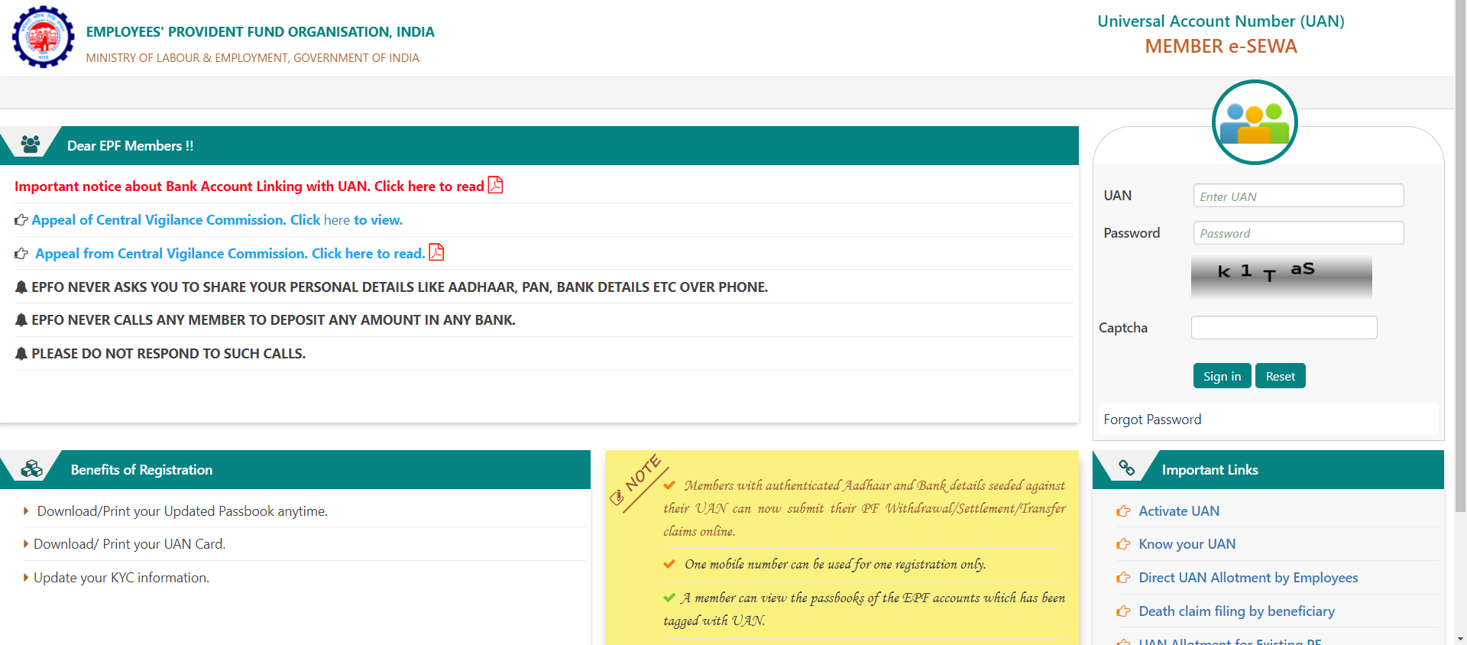
E- nomination (procedure)
Login to UAN member portal (https://unifiedportal-mem.epfindia.gov.in/memberinterface/)

Slide 9
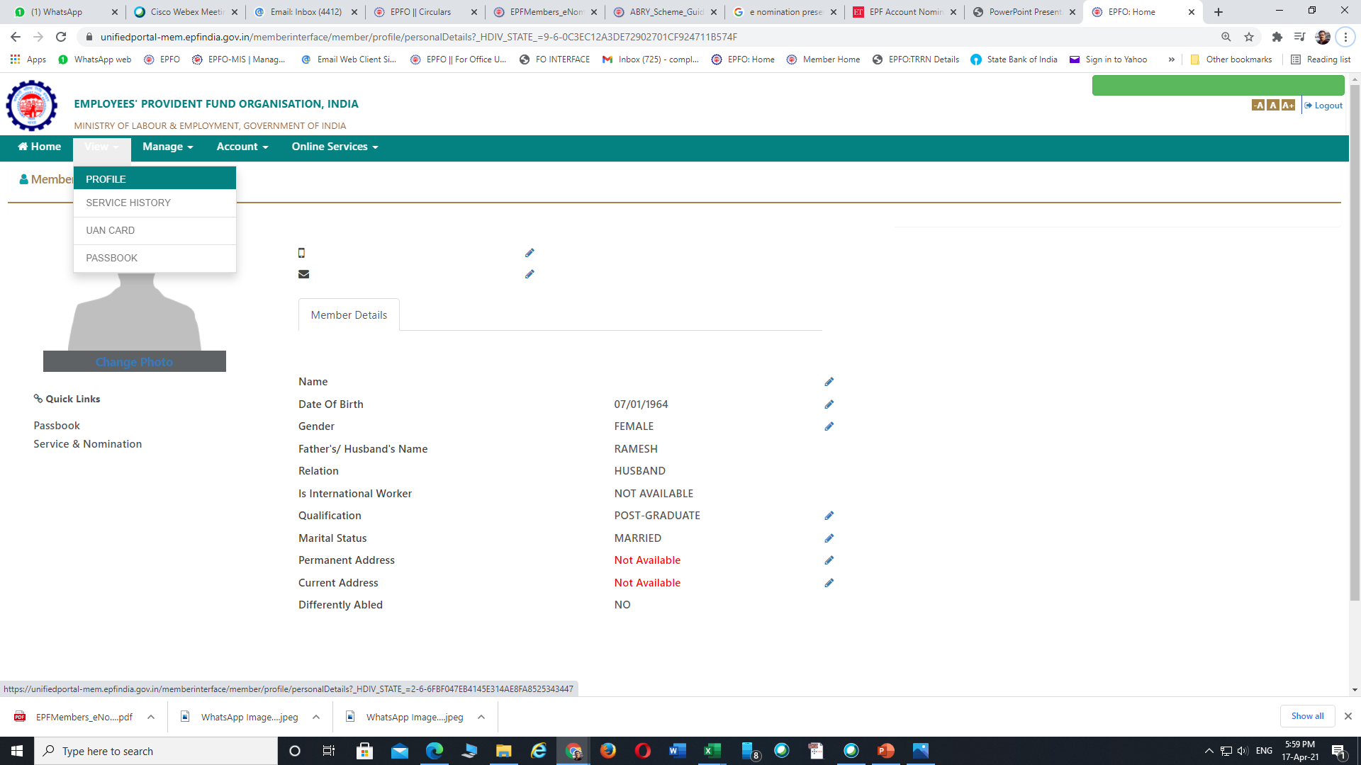
E- nomination (PROFILE UPDATION)
Open “View” >> “Profile” and update all the details of the member if any one left out

Slide 10
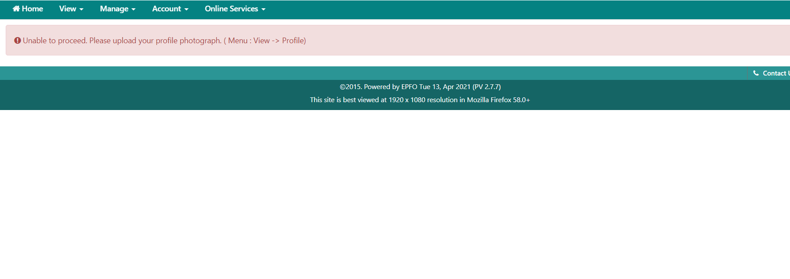
E- nomination (PHOTO UPLOAD)
E- nomination cannot proceed without uploading members photo

Slide 11
E- nomination (PHOTO UPLOAD)
Members photo can be uploaded through >> MEMBER PROFILE >> CHANGE PHOTO option

Slide 12
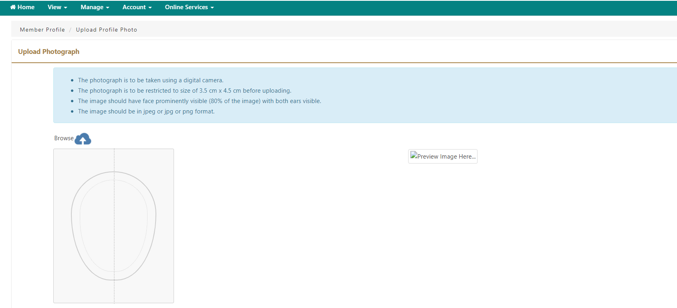
E- nomination (PHOTO UPLOAD)
Upload the Photo (3.5cm x 4.5cm) through the Browse option

Slide 13
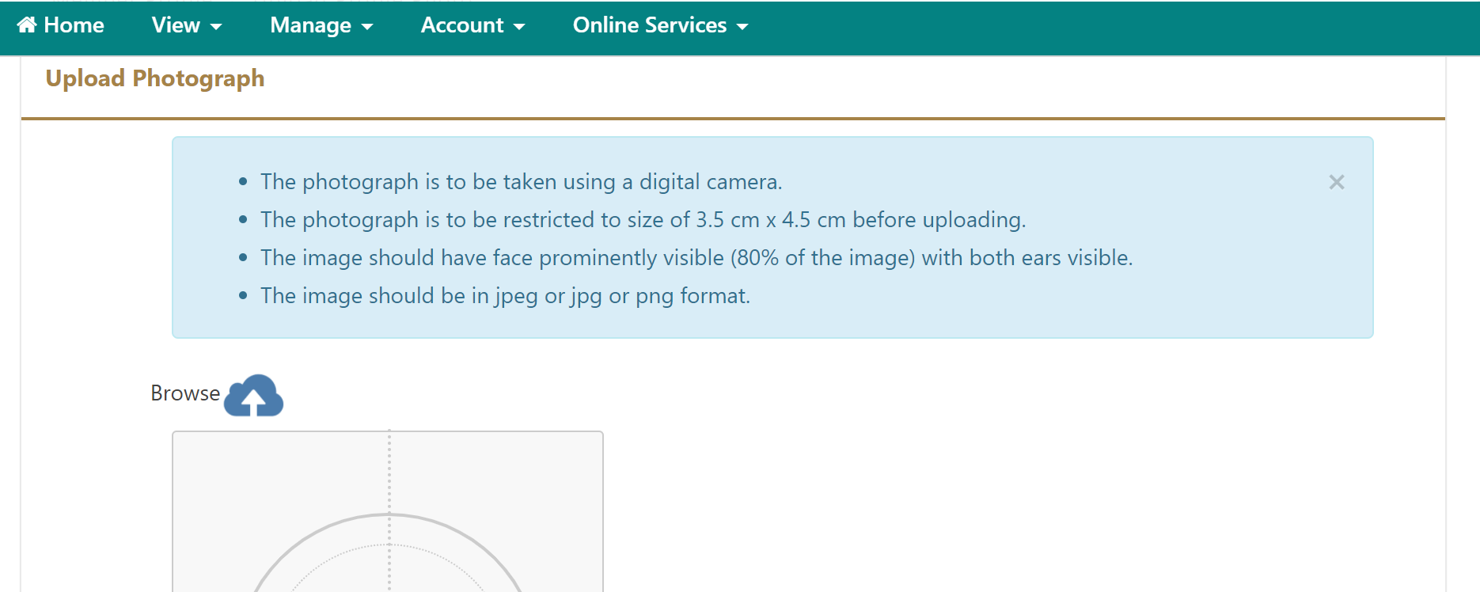
E- nomination (PHOTO UPLOAD)
Things to remember while uploading the Photo

Slide 14
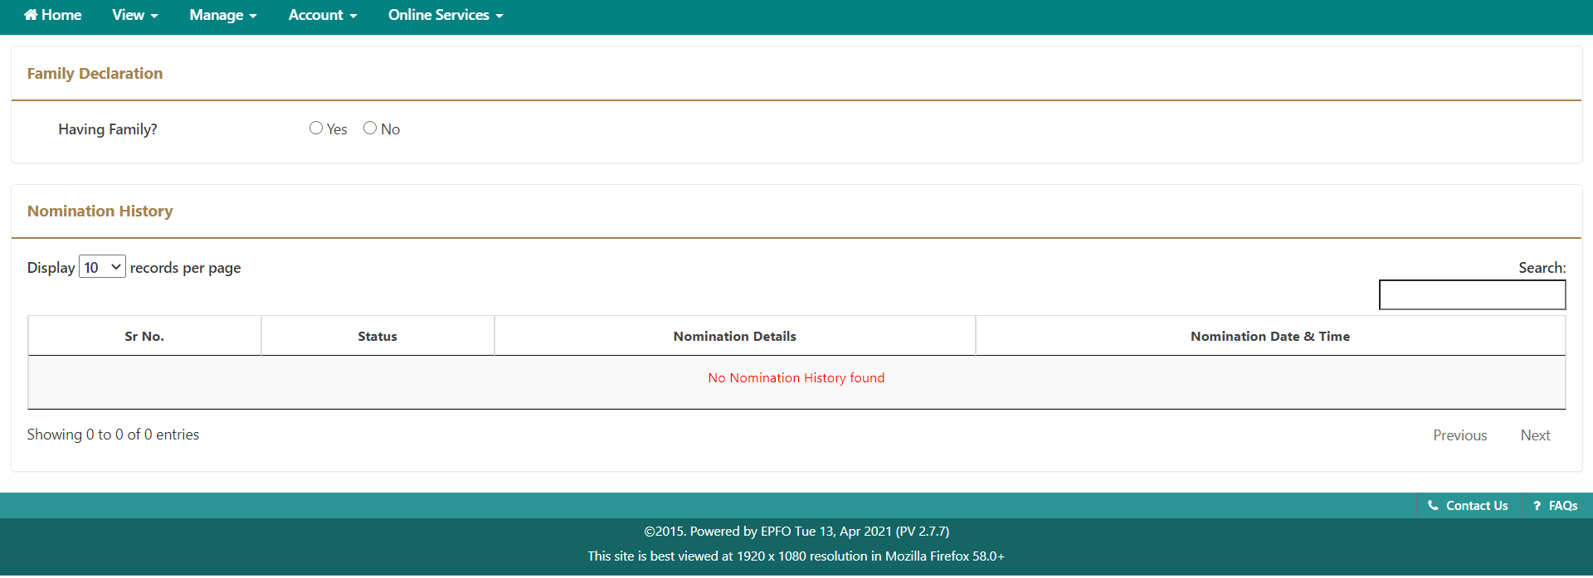
E- nomination (procedure)
Select the appropriate option of “Having family” of member

Slide 15
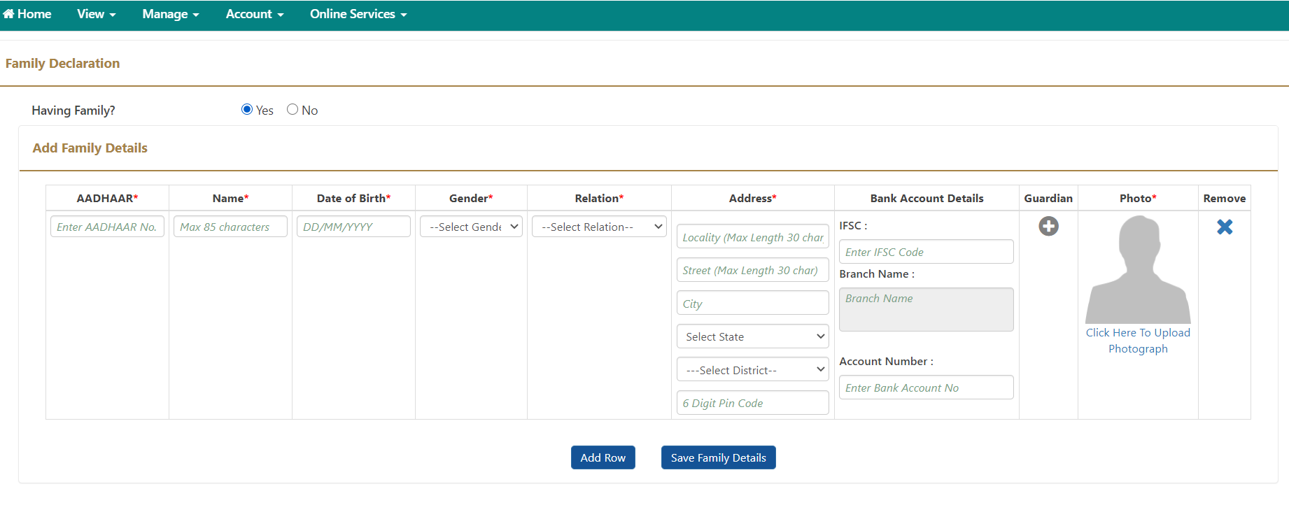
E- nomination (family details entry)
Fill up the necessary details in all the columns and upload the photograph of the nominee and then SAVE.
“ADD ROW” option can be used to add details of multiple nominees if required

Slide 16
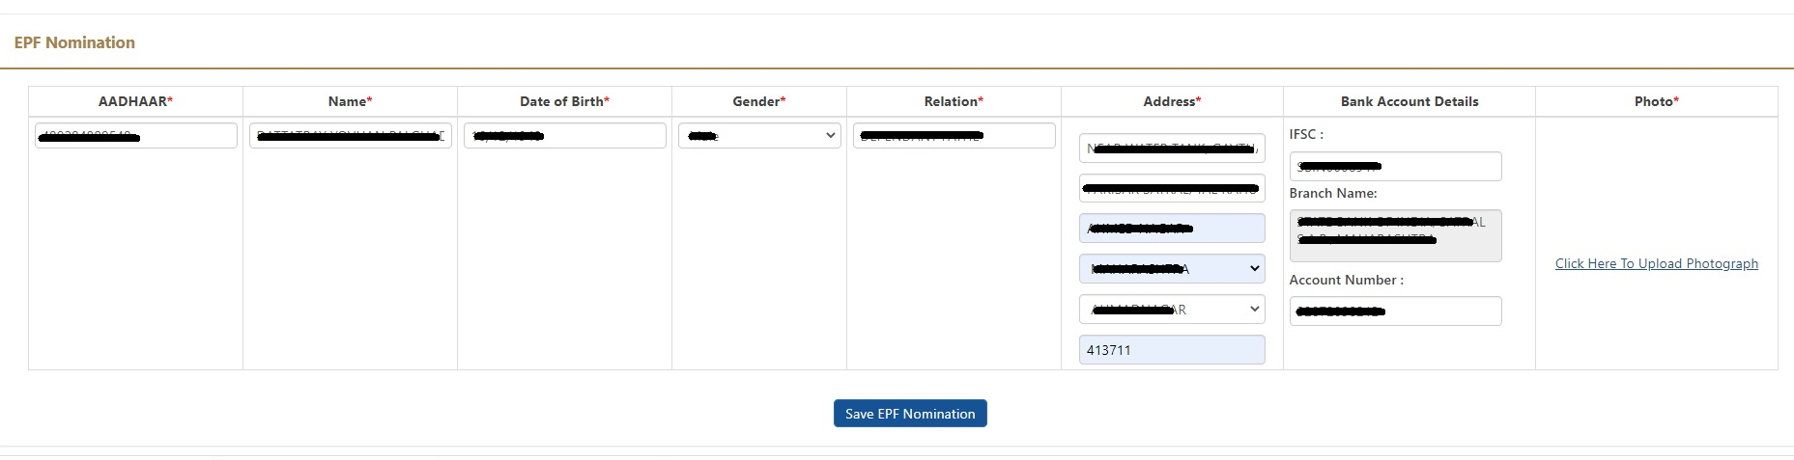
E- nomination (EPF NOMINATION)
Fill up the necessary details of the nominee against Provident Fund Scheme nomination.
Then SAVE EPF Nomination.

Slide 17
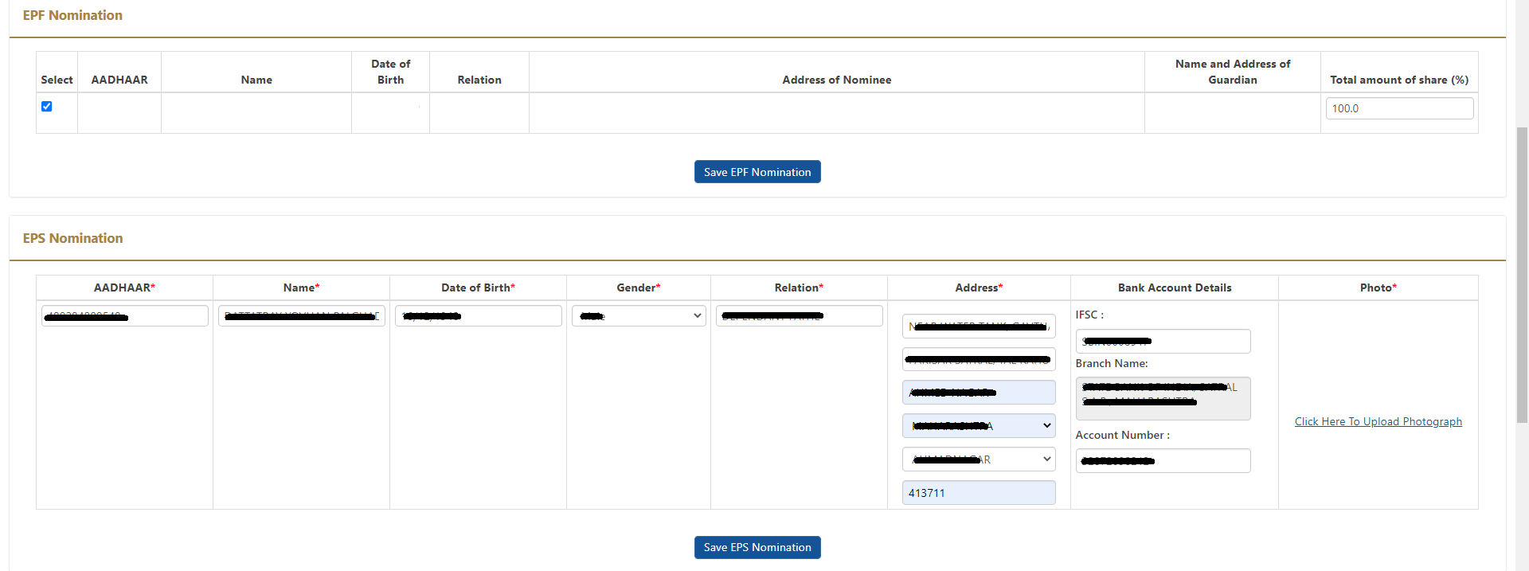
E- nomination (EPs NOMINATION)
Fill up the necessary details of the nominee against Pension Fund Scheme nomination just like which is done in the case of EPF nomination.
Then SAVE EPF Nomination.

Slide 18
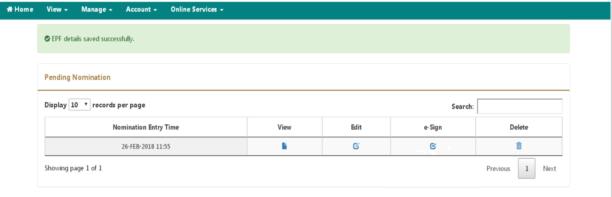
E- nomination (e-signing)
Now the nomination details are to be approved through e-sign (USING AADHAR)

Slide 19
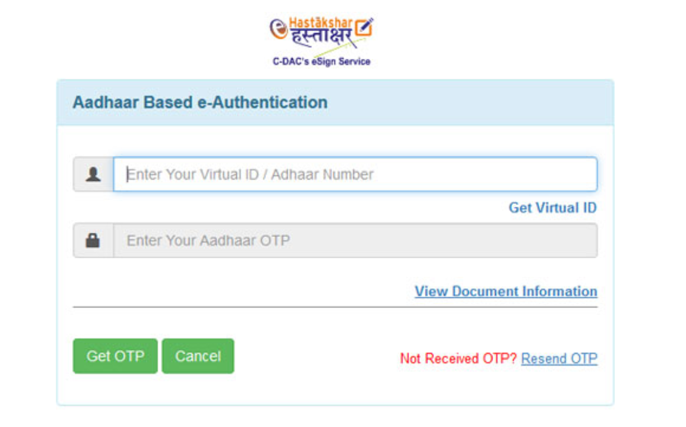
E- nomination (e-signing)
On clicking “e-sign”, a page will be opened for “Aadhar Based e-Authentication”, through which it needs to insert the VIRTUAL ID. This can be generated by the following procedure ………

Slide 20
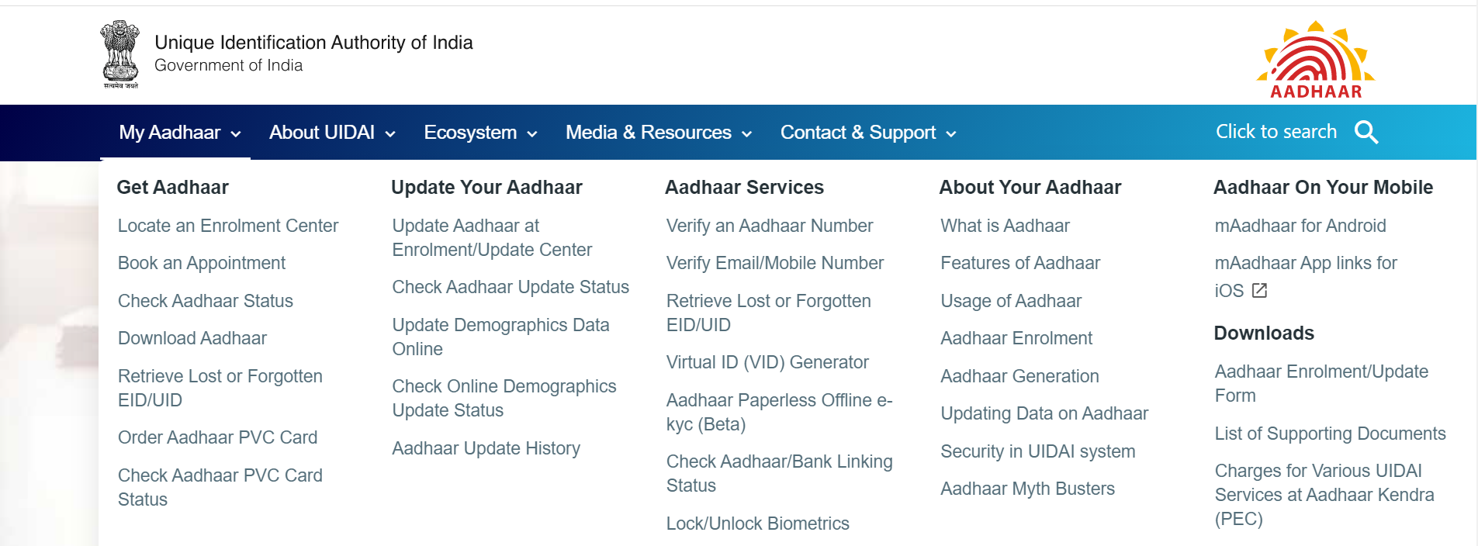
E- nomination (virtual id generator)
Pl login to www.uidai.gov.in site for creation of “VIRTUAL ID”

Slide 21
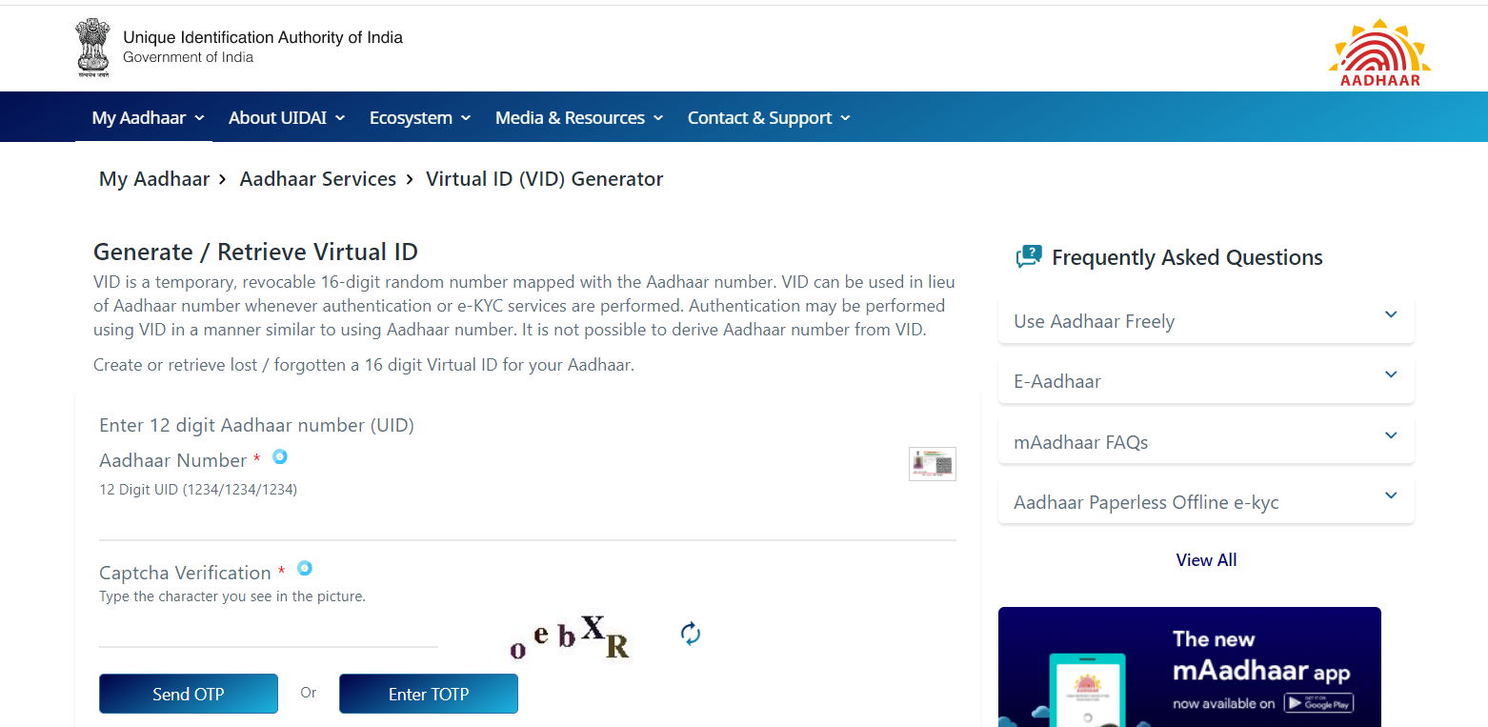
E- nomination (virtual id generator)
Provide the Aadhar number followed by Captcha, OTP will be sent to registered mobile no.

Slide 22
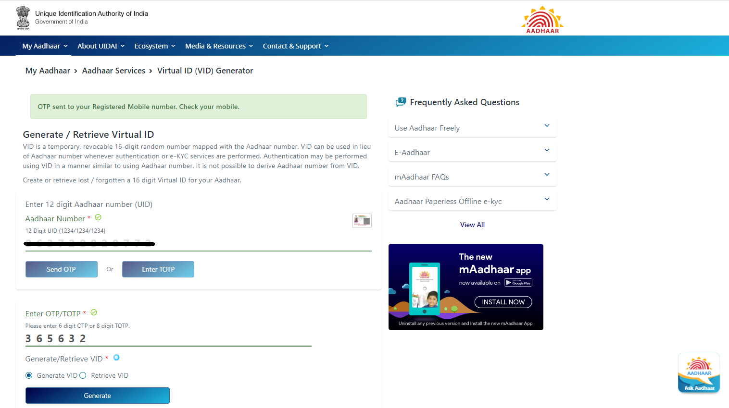
E- nomination (virtual id generator)
On entering OTP, 16 digit Virtual ID will be sent to Aadhar registered mobile number

Slide 23
E- nomination (e-signing)
Now, in the Nomination e-sign page, enter virtual ID which is received from Aadhar portal and click on GET OTP
On entering successful entry of OTP, the nomination will be signed digitally.

Slide 24
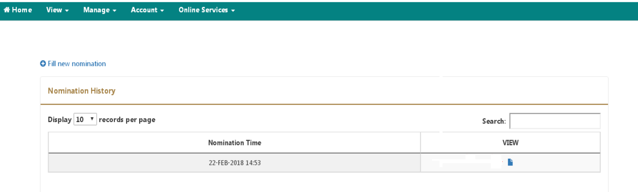
E- nomination (pdf view)
The PDF copy of the nomination can be viewed by clicking on VIEW button

Slide 25
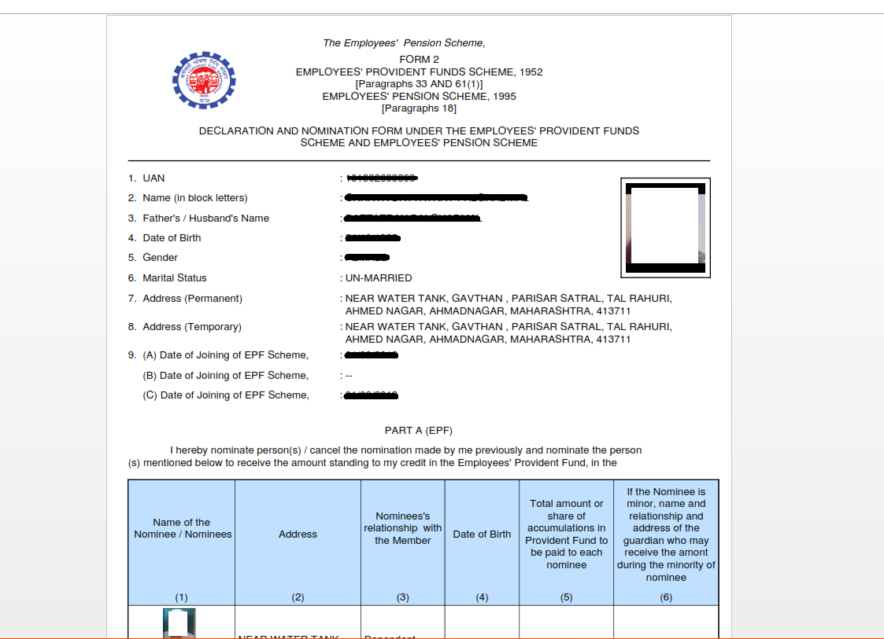
E- nomination (pdf view)

Slide 26
THANKS FOR WATCHING

